Slide 1
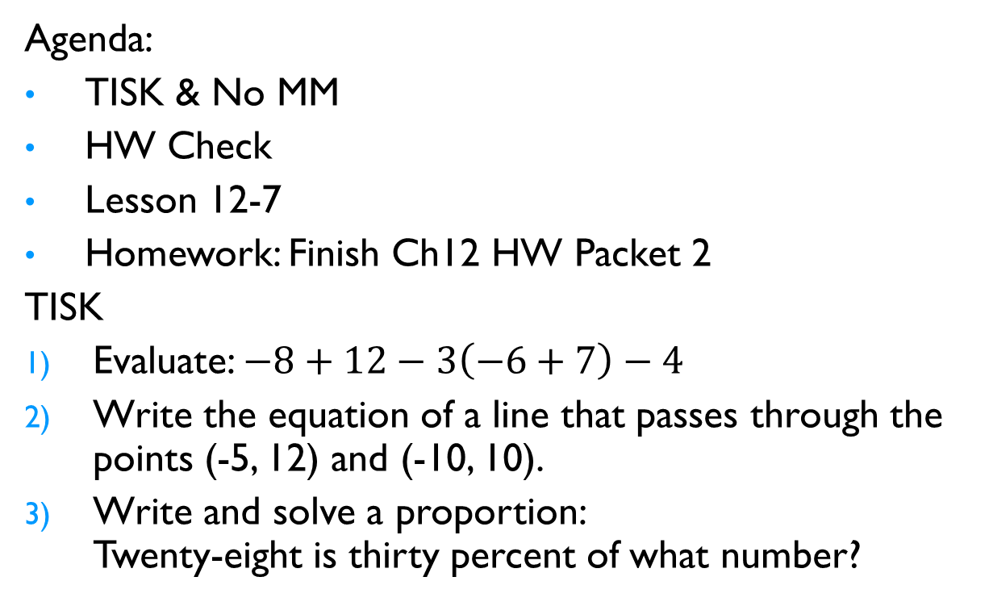
Monday, February 4, 2013
Agenda:
TISK & No MM
HW Check
Lesson 12-7
Homework: Finish Ch12 HW Packet 2
TISK
Evaluate: $−8+12−3\left(−6+7\right)−4$
Write the equation of a line that passes through the points (-5, 12) and (-10, 10).
Write and solve a proportion:
Twenty-eight is thirty percent of what number?

Slide 2
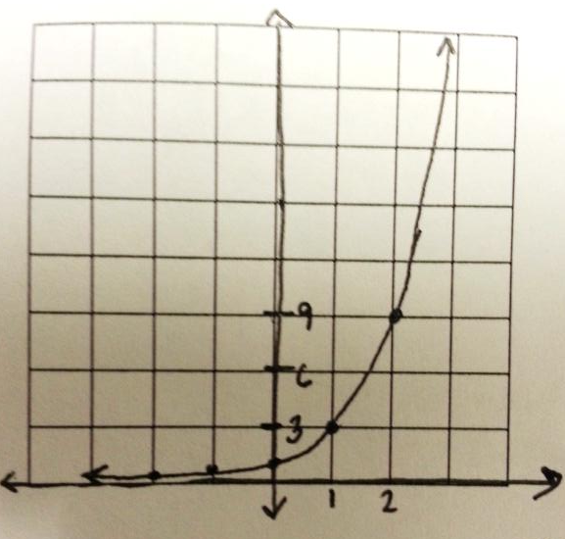
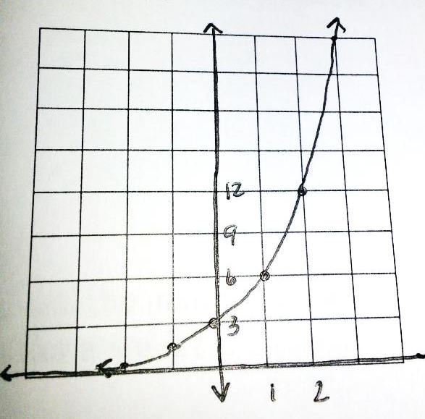
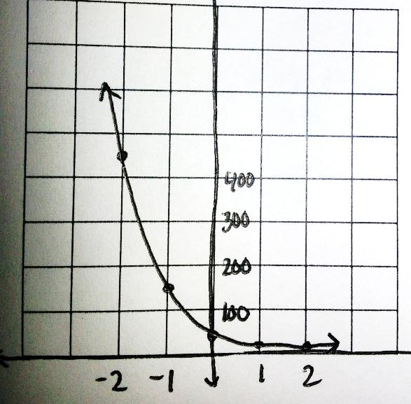
Homework Check

Slide 3
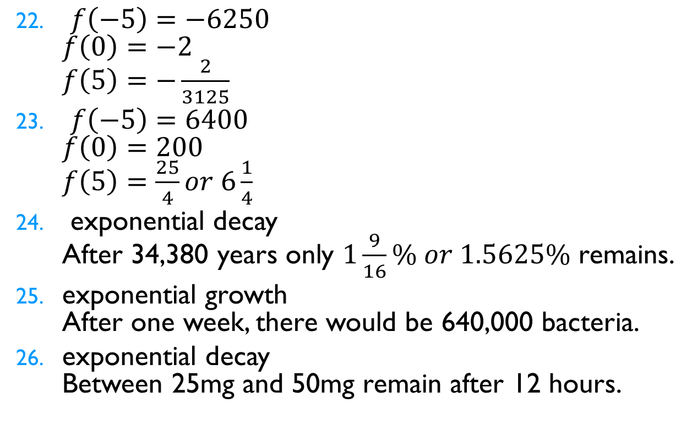
Homework Check
$f\left(−5\right)=−6250$
$f\left(0\right)=−2$
$f\left(5\right)=−\frac{2}{3125}$
$f\left(−5\right)=6400$
$f\left(0\right)=200$
$f\left(5\right)=\frac{25}{4}or 6\frac{1}{4}$
exponential decay
After 34,380 years only $1\frac{9}{16}\% or 1.5625\%$ remains.
exponential growth
After one week, there would be 640,000 bacteria.
exponential decay
Between 25mg and 50mg remain after 12 hours.

Slide 4
§12-7 Quadratic Functions
What makes a function quadratic?
  The highest power of the independent variable is 2.
Quadratic Functions have graphs that look like either
or

Slide 5
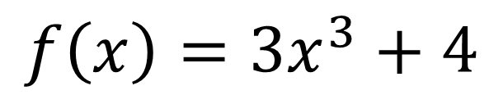
§12-7 Quadratic Functions
Is it a quadratic function?
$$f\left(x\right)=3x^{3}+4$$
No!
The highest power can only be 2.

Slide 6
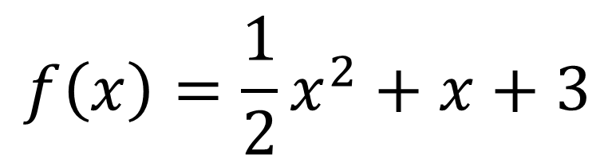
§12-7 Quadratic Functions
Is it a quadratic function?
$$f\left(x\right)=\frac{1}{2}x^{2}+x+3$$
Yes!

Slide 7
§12-7 Quadratic Functions
Is it a quadratic function?
No!
Wrong shape.

Slide 8
§12-7 Quadratic Functions
Is it a quadratic function?
Yes!

Slide 9
§12-7 Quadratic Functions
Is it a quadratic function?
Yes!

Slide 10
§12-7 Quadratic Functions
Is it a quadratic function?
No!
It’s not a function.

Slide 11


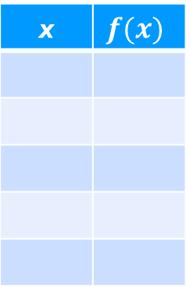


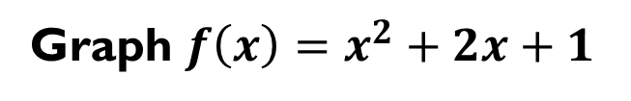






§12-7 Quadratic Functions
Graph $f\left(x\right)=x^{2}+2x+1$
To graph a
quadratic function,
  Choose 5 x-values:
    Two positive, two negative, and zero.
  Evaluate the function at those values.
  Plot the points.
  Connect with a smooth curve.
x | $$f(x)$$
x
-2
-1
0
1
2
$$1$$
$$f\left(−2\right)={(−2)}^{2}+2(−2)+1$$
$$0$$
$$f\left(−1\right)={(−1)}^{2}+2(−1)+1$$
$$1$$
$$f\left(0\right)={(0)}^{2}+2(0)+1$$
$$4$$
$$f\left(1\right)={(1)}^{2}+2(1)+1$$
$$9$$
$$f\left(2\right)={(2)}^{2}+2(2)+1$$

Slide 12
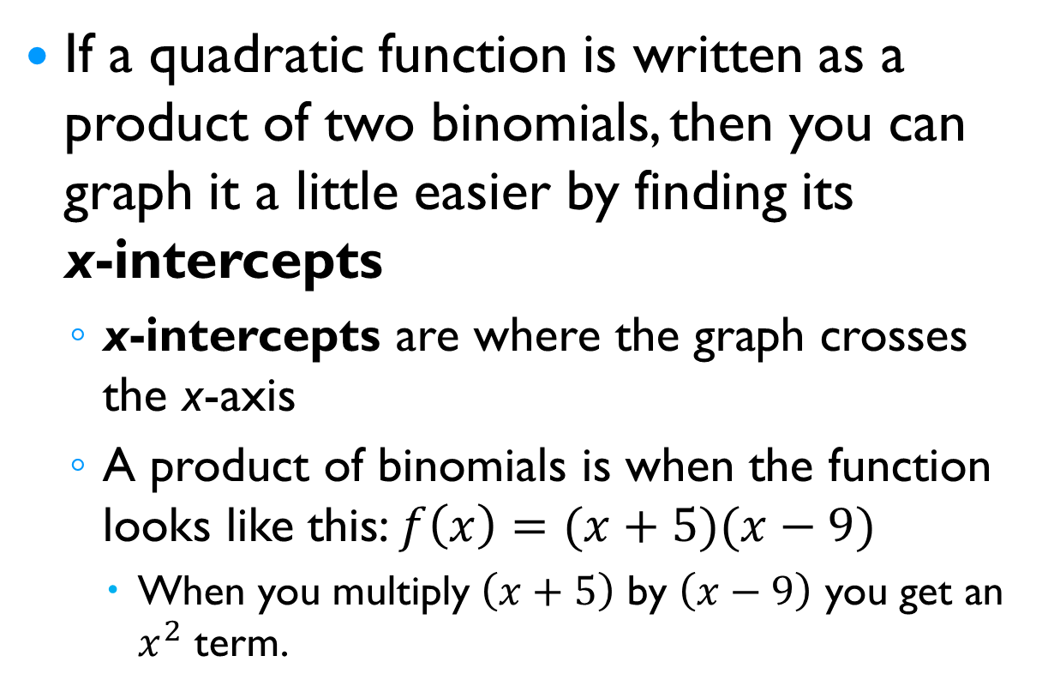
§12-7 Quadratic Functions
If a quadratic function is written as a product of two binomials, then you can graph it a little easier by finding its
x-intercepts
  x-intercepts are where the graph crosses the x-axis
  A product of binomials is when the function looks like this: $f\left(x\right)=(x+5)(x−9)$
    When you multiply $\left(x+5\right)$ by $\left(x−9\right)$ you get an $x^{2}$ term.

Slide 13
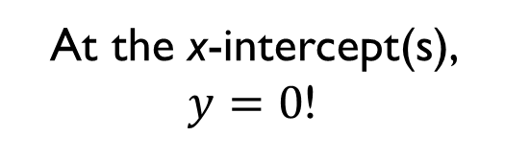
§12-7 Quadratic Functions
If the x-intercepts are where the graph crosses the x-axis, what is the y-value at that point?
At the x-intercept(s), $y=0$!

Slide 14
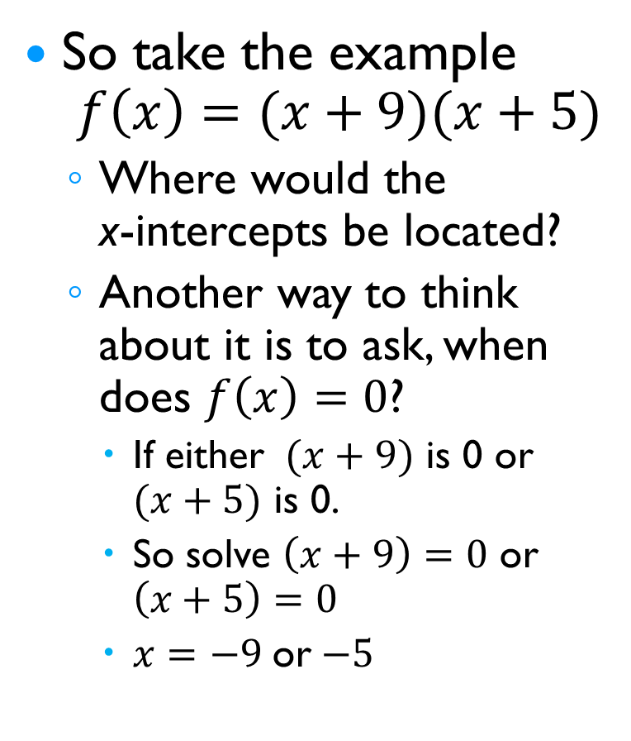
§12-7 Quadratic Functions
So take the example
$f\left(x\right)=(x+9)(x+5)$
  Where would the
  x-intercepts be located?
  Another way to think about it is to ask, when does $f\left(x\right)=0$?
    If either $(x+9)$ is 0 or $(x+5)$ is 0.
    So solve $\left(x+9\right)=0$ or $\left(x+5\right)=0$
    $x=−9$or$−5$

Slide 15
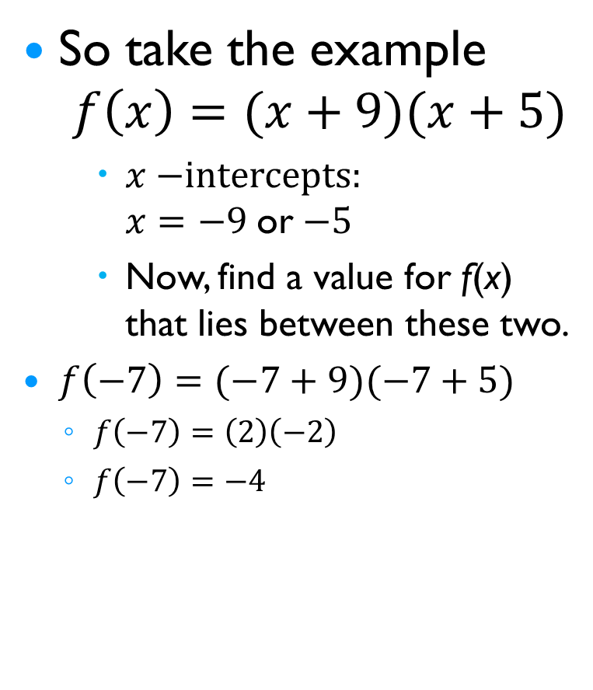
§12-7 Quadratic Functions
So take the example
$f\left(x\right)=(x+9)(x+5)$
    $x−$intercepts:
    $x=−9$or$−5$
    Now, find a value for f(x) that lies between these two.
$f\left(−7\right)=(−7+9)(−7+5)$
  $f\left(−7\right)=\left(2\right)\left(−2\right)$
  $f\left(−7\right)=−4$

Slide 16

§12-7 Quadratic Functions
Find the x-intercepts of the function:
  $f\left(x\right)=\left(x−4\right)\left(x+3\right)$
  $f\left(x\right)=(−x+2)(x−6)$

